Slide 1
Standard I/O and Strings
Dr. B
CS 392: Systems Programming
Spring 2020

Slide 2
First Program with I/O
// hello.c
#include <stdio.h>
int main(int argc, char **argv) {
printf("Hello, world!\n");
return 0;
}
Compiling in virtual machine:
$: gcc -g hello.c -o hello // Why do we use -g here? How about -O3?

Slide 3
First Program with I/O
// hello.c
#include <stdio.h>
int main(int argc, char **argv) {
printf("Hello, world!\n");
return 0;
}
// Where is the printf function found?

Slide 4
Header Files
Each header file contains one or more function declarations, data type definitions, and macros.
Good place to declare your own functions declarations, types, and macros as it abstracts interface from implementation.
Try to avoid defining variables or writing function implementations inside.
#include <stdio.h>
// This header includes the declaration of printf.
// Try "whereis stdio" in the shell.
int main(int argc, char **argv) {
printf("Hello, world!\n");
return 0;
}

Slide 5
Create Your Own Header File (1)
Each header file contains one or more function declarations, data type definitions, and macros.
extern int g_log_level;
void log_to_file(int );
typedef unsigned int uint_t;
#define CONSTANT 1000
#include "myheader.h" // include your own headerfile
int main() {
uint var_0; // use the new type uint
var_0 = 0;
g_log_level = 1; //use the external variable
log_to_file(CONSTANT); //use CONSTANT
return 0;
}
A new header file “myheader.h”
int g_log_level = 0;
void log_to_file(int errorcode)
{
…
}
Use of your own header file
File (library) providing logging functionality -- “log.c”

Slide 6
Create Your Own Header File （2）
Including a header file twice will cause big problem
Can occur when source file includes header1.h and header2.h, and header1.h also includes header2.h
// myheader1.h
extern int g_log_level;
void log_to_file(int );
typedef unsigned int uint;
#define CONSTANT 1000
// main.c
#include “myheader1.h”
#include “myheader2.h” // this includes myheader1.h again!
int main(int argc, char**argv){
return 0;
}
// myheader2.h
#include “myheader1.h”
#define LOG_LEVEL g_log_level // Use g_log_level from myheader1.h

Slide 7
Create Your Own Header File （3）
Use “#ifdef” and “#ifndef” to avoid duplicated include
“#ifdef” and “#ifndef” are used in pre-processing by compilers
// myheader1.h
#ifndef MY_HEADER1_H_
#define MY_HEADER1_H_
extern int g_log_level;
void log_to_file(int );
typedef unsigned int uint;
#define CONSTANT 1000
#endif
// main.c
#include “myheader1.h” // This defines MY_HEADER1_H
#include “myheader2.h” // myheader1.h will not be included int main(int argc, char **argv) {
return 0;
}
// myheader2.h
#ifndef MY_HEADER2_H_
#define MY_HEADER2_H_
#include “myheader1.h”
#define LOG_LEVEL g_log_level
#endif

Slide 8
Where can compiler find headers?
A list of standard system directories
Type: gcc -E -Wp,-v -xc /dev/null
The current working directories
Any headers under the same directory as the source file can be found
Any folders specified by -I option
Try to add -I/<path to your header files> as a compilation option

Slide 9
Standard Output
In Unix-like operating systems, such as Linux, macOS X, and BSD, stdout is defined by the POSIX standard.
Its default file descriptor number is 1. In the terminal, standard output defaults to the user's screen.
Libc: printf()
// hello.c
#include <stdio.h>
int main(int argc, char **argv) {
printf(“Hello, world!\n");
return 1;
}
Syscall: write(fd = 1)
Kernel: write(fd = 1)

Slide 10
Formatted Output
Format String
A control parameter used by a class of functions in the input/output libraries
Control the locations and methods to translate variables to characters.
int printf(const char *format, var1, var2, …); printf("The variables are %c, %d, %lu\n", var_0, var_1, var_2);
// each specifier (starting with %) will be replaced by the corresponding variable.
// This will print "The variables are A, -1, 2"
// hello.c
#include <stdio.h>
int main(int argc, char **argv) {
char var_0 = 'A';
int var_1 = -1;
unsigned long var_2 = 2;
printf("The variables are %c, %d, %lu\n", var_0, var_1, var_2);
// each specifier(starting with %) will be replaced by the
// corresponding variable.
// This will print "The variables are A, -1, 2"
return 0;
}

Slide 11
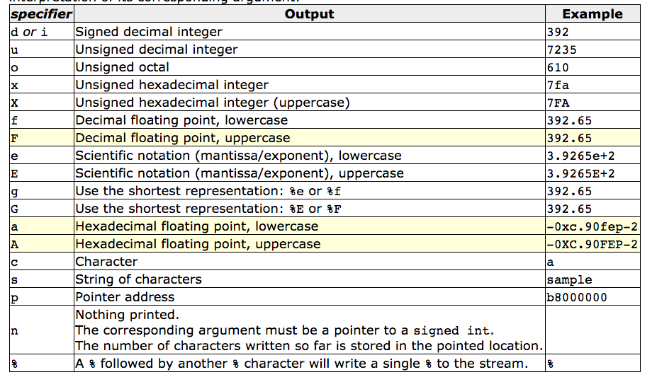
Format Specifiers

Slide 12
Format String
Do not use user supplied strings as format strings
Specifiers and variables must match
Unmatched specifiers may lead to undefined behaviors
// hello.c
int main(int argc, char **argv) {
char var_0 = 'A';
int var_1 = -1;
unsigned long var_2 = 2;
printf("The variables are %c, %d, %lu\n", var_0, var_1); // Is this right?
return 0;
}

Slide 13
Strings in C Program
Or strings
Arrays of characters terminated by the null character '\0'
Also called null-terminated strings
Examples:
char str[10];
A string that fits 9 characters + the terminating null character
char str[] = "Hello, world!"
str is automatically allocated to hold the string + the terminating null character
char *str = "Hello, world!"
A constant string is created and str points to its beginning
It cannot be updated
Check out this blog: https://c-for-dummies.com/blog/?p=3475

Slide 14
Print Strings
// hello.c
#include <stdio.h>
int main(int argc, char **argv) {
char str[] = "Hello, world!";
printf("%s\n", str); // This will print "Hello, world!"
return 0;
}

Slide 15
Other Standard Output Functions
int putchar(int c);
Write a single character to standard output
int puts(char *str);
Write a string to standard output
#include <stdio.h> // header file to include putchar and puts
int main(int argc, char **argv) {
char var_0 = 'A';
putchar(var_0);
puts(argv[0]);
// argv[0] points to the string containing the program name.
return 0;
}

Slide 16
Standard Input
In Linux, stdin is defined by the POSIX standard.
Its default file descriptor number is 0. In the terminal, standard input defaults to the user’s keyboard.
int scanf(const char *format, ...);
Libc: scanf()
// hello.c
#include <stdio.h>
int main(int argc, char **argv) {
int var0;
char str[20];
scanf("%d", &var0);
// Why is the & operator required?
scanf("%s", str);
// Receive input from keyboard
// What if more than 19 chars are typed to var2?
scanf("%d%s", &var0, str);
// Can specify to reach multiple pieces of data in one call
return 0;
}
Syscall: read(fd = 0)
Kernel: read(fd = 0)
Hello, World

Slide 17
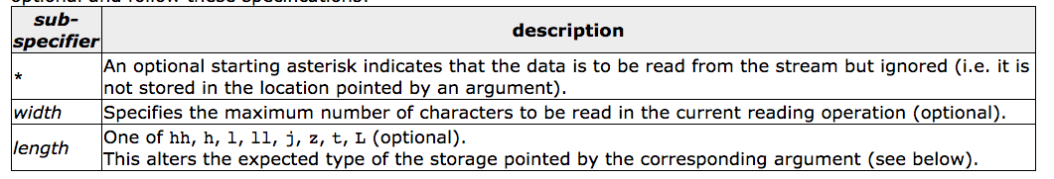
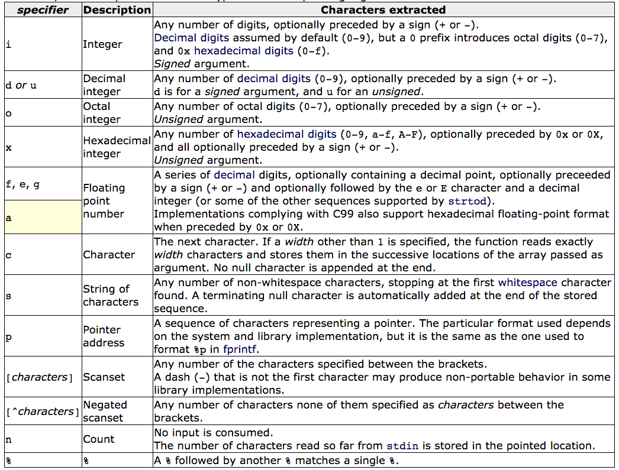
Format Strings
Format: %[*][width][length]specifier

Slide 18
Other Standard Input Functions
int getchar(void);
Returns the next character from the standard input (stdin)
char *gets(char *str);
Reads a line from stdin into the buffer pointed to by str until either a terminating newline or EOF (Ctrl D in Linux), which it replaces with a null byte ('\0').
#include <stdio.h> // header file to include getchar and gets
int main(int argc, char **argv) {
char var_0;
char str[10]; // We use it as a string
var_0 = getchar();
gets(str);
// What if you type more than 9 chars?
return 1;
}

Slide 19
Other Standard Input Functions
char *fgets(char *restrict buf, int n, FILE *restrict fp);
Reads at most n-1 characters from fp until a newline is found. The characters including to the newline are stored in buf. The buffer is terminated with a 0.
// C program to illustrate fgets()
#include <stdio.h>
#define MAX 16
int main() {
char buf[MAX];
fgets(buf, MAX, stdin);
printf("String is: %s\n", buf);
return 0;
}

